Slide 1










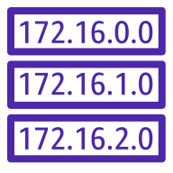





Microservice Architecture on Amazon EKS
AWS Cloud
AWS Region
Amazon VPC
EKS Cluster
Availability Zone
Availability Zone
Public subnet
Public subnet
ACM
NAT Gateway
NAT Gateway
Route 53
Public RT
Public RT
Private RT
IAM
Private subnet
Private subnet
Elasticache
Control Plane
Control Plane
RDS DB
Worker Node
Worker Node
Worker Node
Worker Node
Kubernetes Ingress
Private RT

